Slide 1
Applications of CNTs & Nano Carbons
ESI Archamps in 2018 Summer
Shuji Tsuruoka, Ph.D., Prof.
Shinshu University, Institute of Carbon Science & Technology
Nagano, Japan

Slide 2
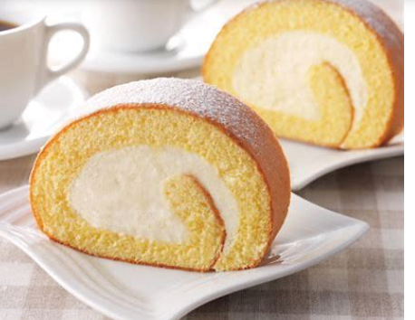
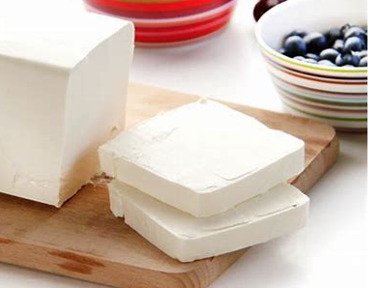
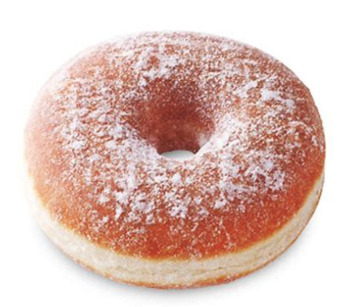
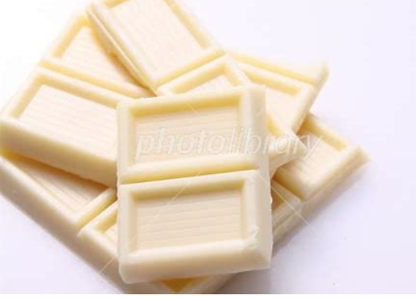
Successful Nano Biz

Slide 3

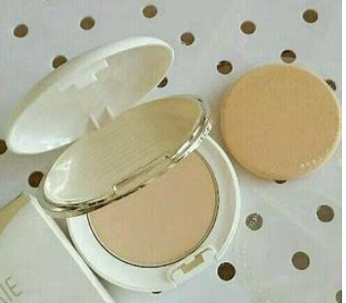


-ditto-

Slide 4
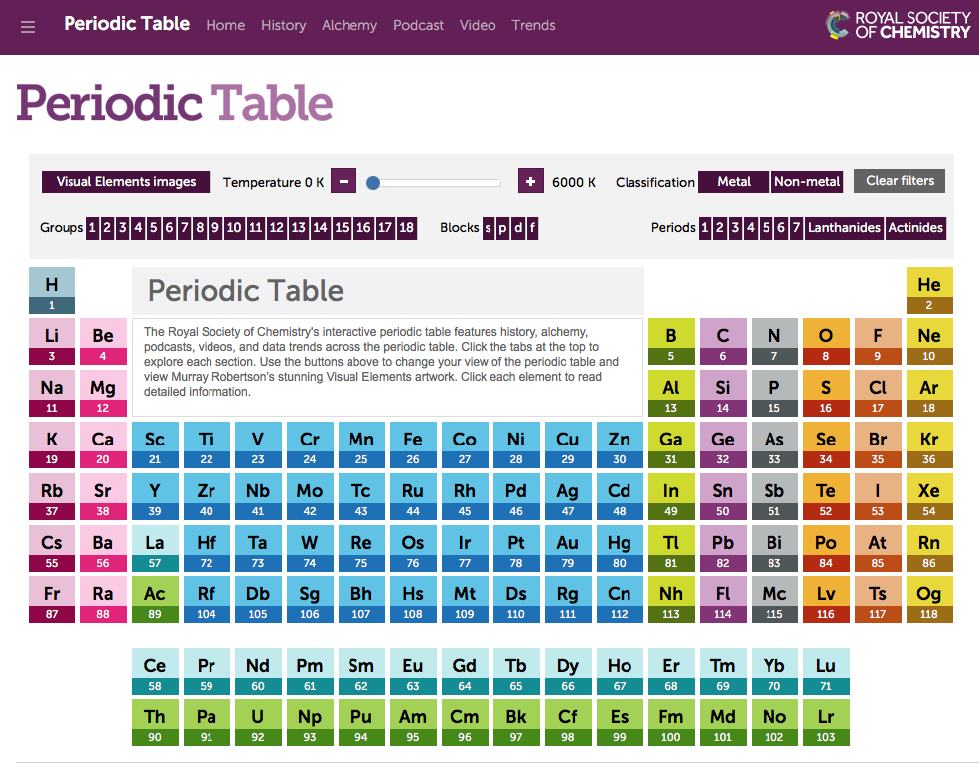
What Carbon Can Do?
Semiconductors

Slide 5
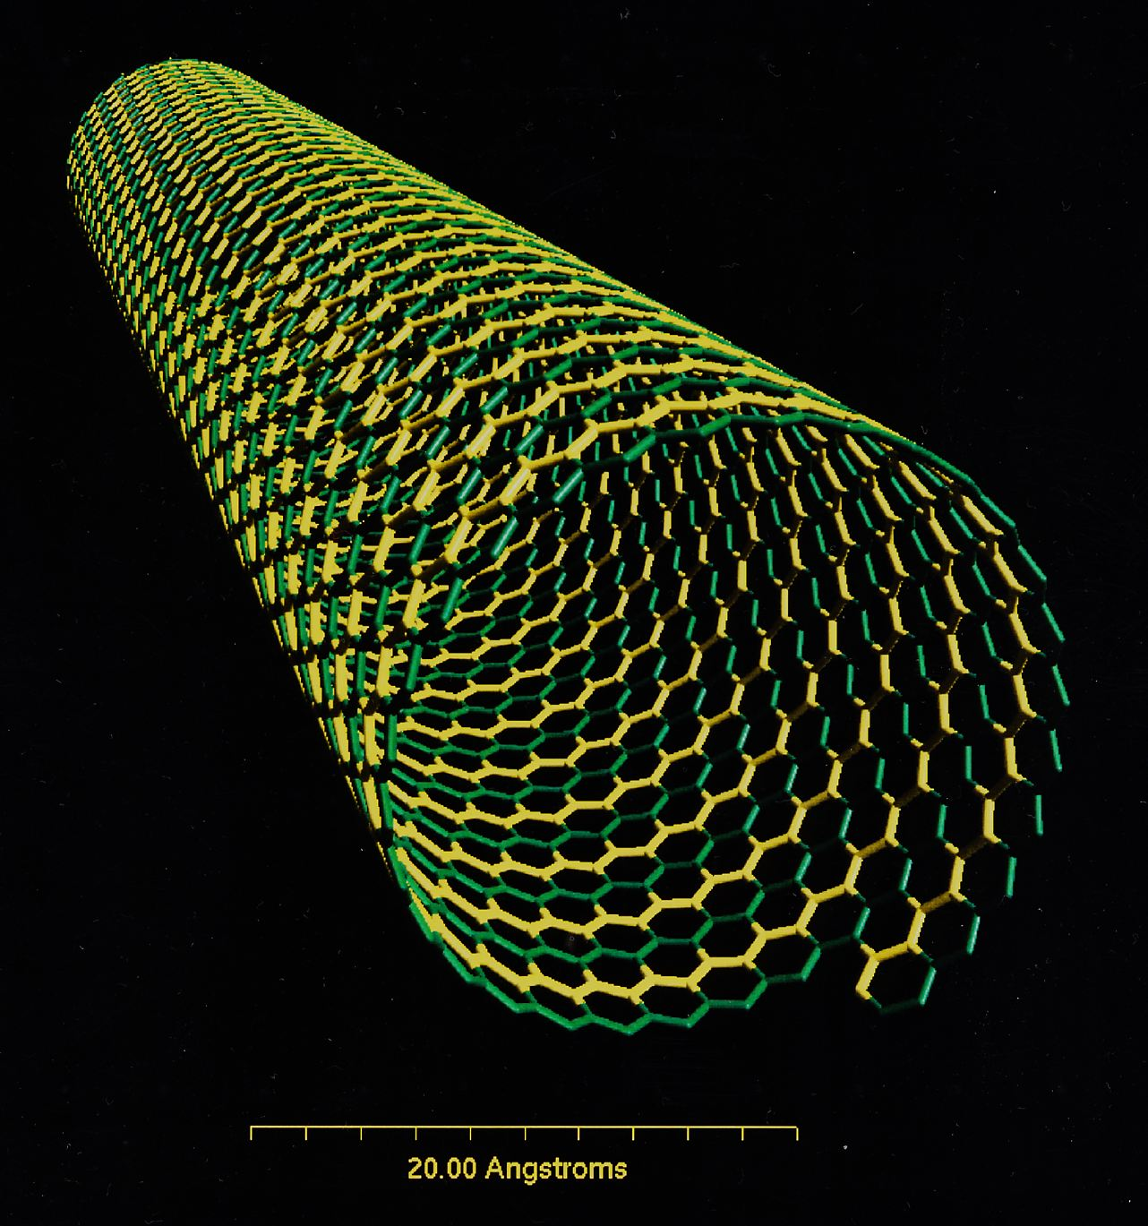
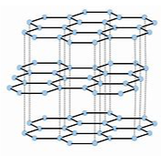
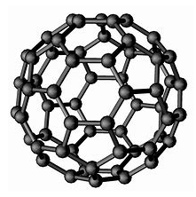

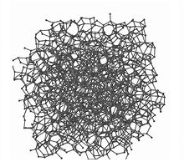
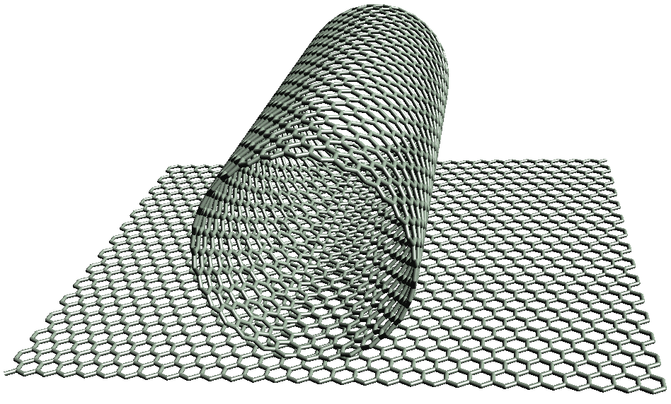
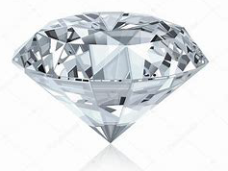
Carbon Allotropes
Carbon Nanotube
Graphite
Fullerene
Carbon Nanohorn
Amorphous Carbon
Diamond
Graphene

Slide 6
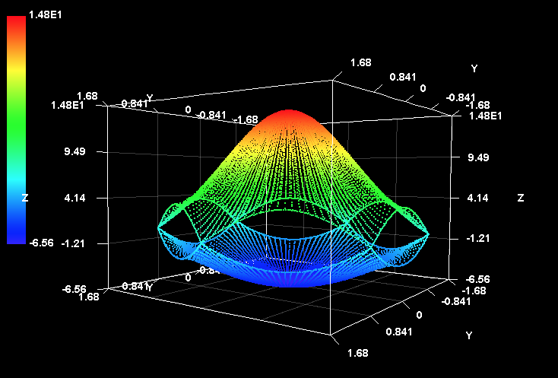
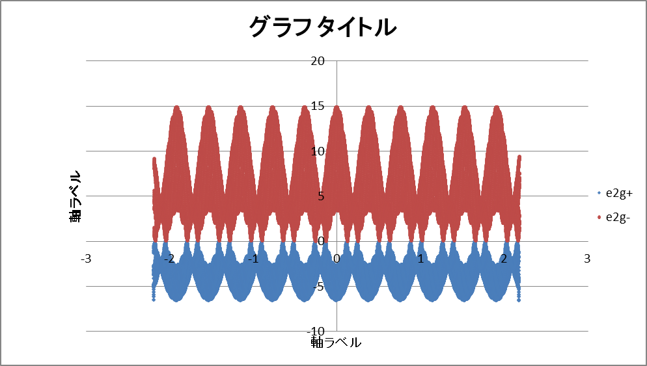


What Characteristics of sp² Carbons
 | Questions | Notes
1 | Has band gap? | Graphene is no-band gap semiconductor. CNTs depend on their chirality.
2 | Synthesized commercially? | [Yes[ Graphite, Amorphous C, MWCNTs, DWCNTs, SWCNTs Pseud-graphene, Fullerene [Yes/No] Pure graphene [No] Nano Horn
3 | What purity we can obtain? | Very High: Graphite High: DWCNTs, MWCNTs, Fullerene Metal impurities: MWCNTs, SWCNTs, Graphene
4 | Can react with the other atoms/functional groups? | [Yes] except pure Graphite/Amorphous C
5 | Can mix into media/matrix? | Depends on media/matrix. Homogeneous CNT distribution in solution and resin matrix is possible.
6 | Commercially Available? | [Yes] Graphite, Amorphous C, CNTs, Pseud-graphene, Fullerenes
SWCNT Chirality (15, 0)
Wave Number
Graphene Brillouin zone

Slide 7
History of Nano Carbon Business Development
CNTs
Fullerene
1976：Found MWCNT (M. Endo)
1986：Catalytic CVD (Tibbetts)
1985：Found Fullerene
1987：Hyperion method（Pat）
1988：Cont. Synthesis Method (M. Endo)
1989：Synthesis method
1990’s： Stacked CNT (GSI Creos)
1990’s VGCF (Showa-Denko)
1991：FIC by Mitsubishi
1992：SWCNTs (Iijima)
Additive to LiB
1999：HiPco (Rice U)
1986: Hyperion
2004：FC by Mitsubishi
2000：CNI
2001: Mitsui
VGCF
2000’s：Toray
2000’s Nanocyl, Bayer,
cNano, Atoche, etc.
Bowling ball, cosmetics, etc.
2009 Hodogaya
2007： to Unidym
CNT Film
Unidym（US) & EIKOS（US)
2000’s：China/Korea
Could not find good applications
CCVD Commercialization
Floating Reaction Commercialization

Slide 8
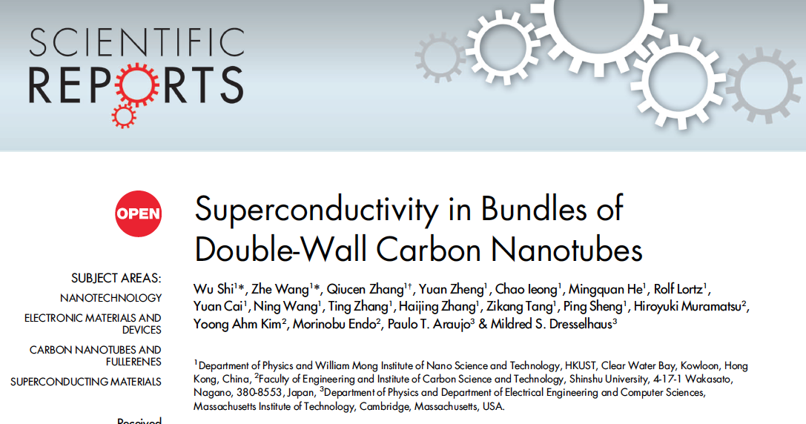
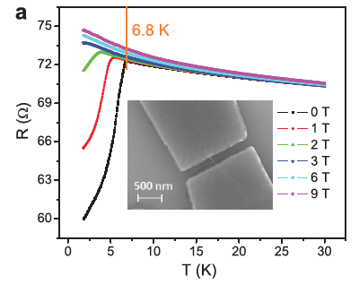
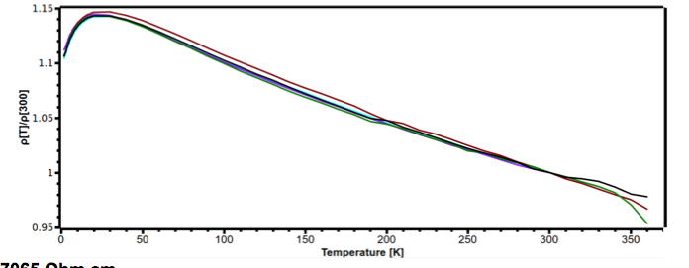
There is Myth about Nano Carbons
1. CNTs are superconductive!?
Courtesy of Prof. Fugetsu at Hokkaido University
Resistivity does not become zero
None proves CNTs are superconductive
The First Principle Theory calculation: Conditional calculation
Measurement in microscope; under electron bombardment
Relative R

Slide 9
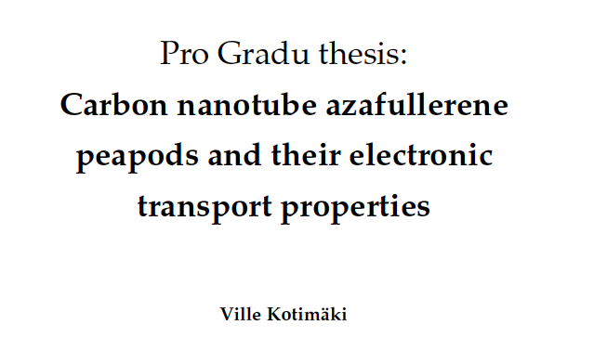
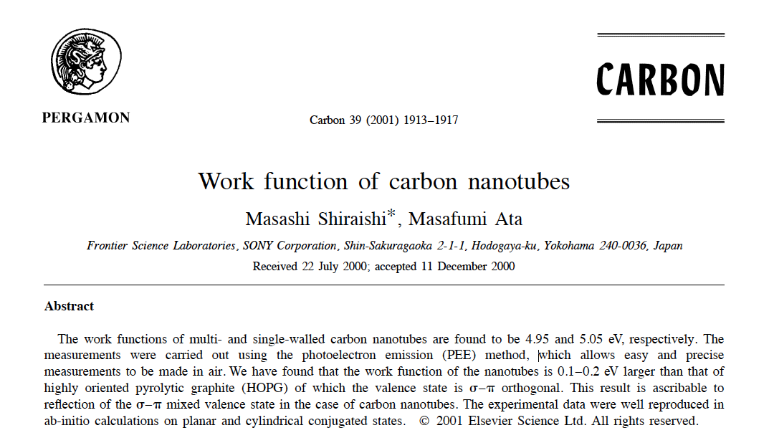
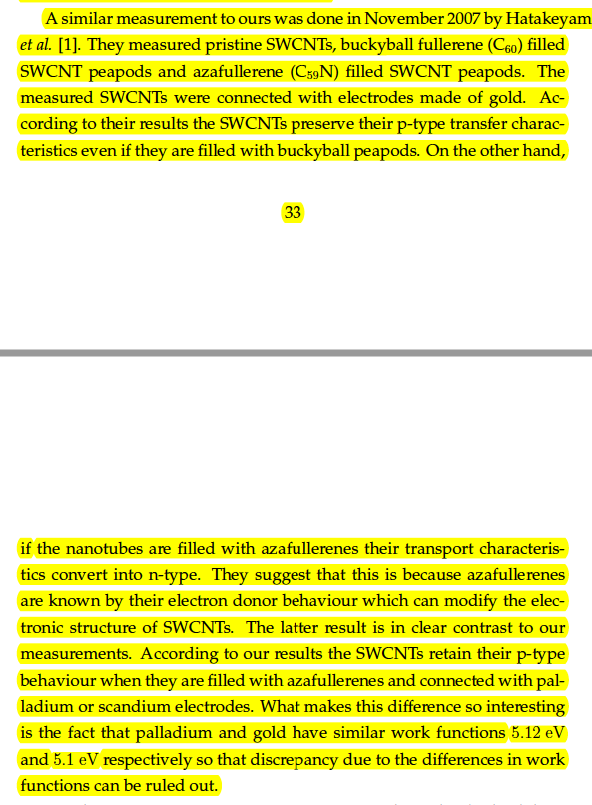
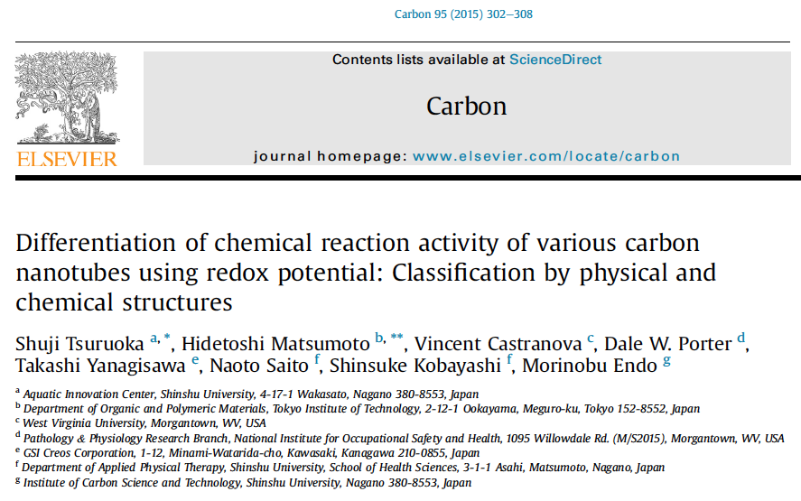
Myth about Nano Carbons
2. CNTs are P type semiconductor
A different Boundary Conditions give alternative results
CNTs scavenge hydroxyl radicals: CNTs are electron donor in water
This is derived from The First Principle theory.
Band-gap exist.
Resulting behaving like electron-absorber

Slide 10
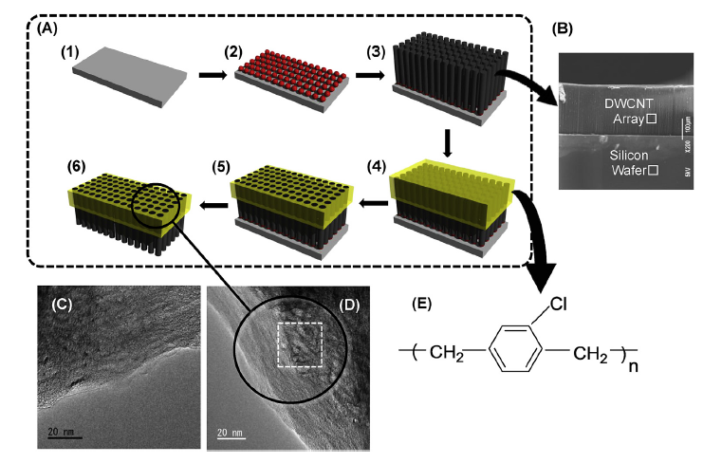
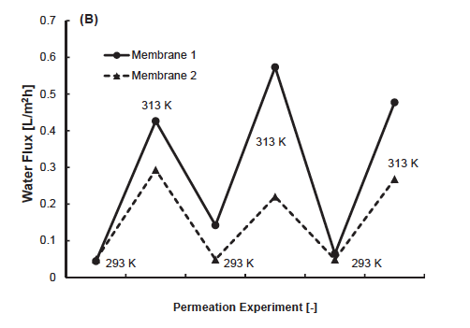
Myth about Nano Carbons
3. Water in CNT confined space freezes at high temperature
MD calculations predict water behaviors in CNT confined space.
MD results suggest high through-put of water in CNTs.
CNTs might have proton transfer ability.
An experimental result shows water motion suppression.
Water particular structures in CNT confined space forms .
The flow rate corresponds to Hagen-Poiseuille flow.
Courtesy of Prof. Matsumoto & Prof. Tsuruoka

Slide 11
Applications of Nano Carbons
Note;
Basic applications of CNTs and Graphene
Graphene definition is vague
Methods to disperse CNTs/ Graphene are the key step
Application Technique/ Applications
Ink/Paint
1) Paint heaters: Flat surface, Transparent
2) Dyeing fibers/yarn: -ditto-
3) Electrical circuit
Intermediate Treatment
Surfactant
Acidic, Sulfonate, Zwitterionic, CMC, etc.
Inorganic
Water only
Surface Treatment
1) Darkest black (Optical use)
2) Mixed-with-metal plated (Ni, Cr)
3) Surface smoothness
Liquid
Dispersion
Mix into
1) Resin composite
2) Metal composite
Yarn/Wire
1) Powder spinning with resin addition
2) Direct spinning
3) Draw & Sticking Sheet
CVD-floating Reaction (incl. E-dips)
CCVD: Substrate-deposited Fluidized-Bed
Vertically-Aligned Growth
Dry Use
Membrane
1) Hollow confined space (CNTs)
2) Direct deposit on substrate & Graphene)

Slide 12
We Carefully Have to Look at…
There are many of Just-Kidding products
Copy-cats to make money
In-Fashion R&D without fundamental knowledge
“Don’t care the safety or regulation”
People are mesmerized …
Cheap-trick products and slow-down product genuine development; Materials are not like IT/AI
A fraud product makes society unhappy
How we should do?
Let us watch US-China trade negotiation (China copy-cat business)
- Almost 100% of products at Walmart are made in China.
- ZTE is giving up smartphone manufacturing
It take a long time for a material before going to the market place.

Slide 13
SWOT Analysis: Nano Makes Sense Industrially?
The argumentative point; Nano is really valuable in the real world?
Carbon forms | Strength
Graphite | 1) Electrically conductive, 2) High purity, 3) Synthesized or mining, 4) Inert chemical, 5) Not toxic in large size, 6) Recycled/ Incinerated, 7) low cost
Amorphous carbon | 1) Inert chemical, 2) Not toxic in large size, 3) Synthesized or mining, 4) Recycled/ Incinerated, 5) Low cost
Carbon fiber | 1) Commercialized, 2) The strongest fiber in tensile strength, 3) Inert chemical, 4) Light density
Fullerenes | 1) Electrically conductive or not conductive, 2) High purity and crystalline form, 3) Synthesized, 4) Reactive, 5) Radical scavenger
CNTs | 1) Electrically & thermally conductive, 2) Variable forms: carbon structures, length, diameter, 3) Inert chemical, 4) Unique characteristics, 5) Commercialized, 6) Industrially adopted, 7) Recycled/ Incinerated
Carbon nanohorn | ?
Graphene, GO | 1) Electrically conductive, 2) Synthesized or cracked from Graphite, 3) Reactive at edge & defects, 4) pseud-graphene/GO are commercialized, 5) Incinerated

Slide 14
SWOT Analysis 2
The argumentative point; Nano is really valuable in the real world?
Carbon forms | Weakness
Graphite | 1) No nano characteristics
Amorphous carbon | 1) No electrical conductivity, 2) With aromatic impurity or must be purified
Carbon fiber | 1) Not highly conductive, 2) Epoxy composite, 3) Epoxy composite is brittle, 4) Costly forming process, 5) Energy guzzler
Fullerenes | 1) Difficult to synthesize and purify, 2) Very expensive, 3) Agglomerated
CNTs | 1) Size distribution, 2) Difficult to disperse in media, 3) Fluffy (low density), 4) Carcinogenic, 5) Expensive (SWCNTs),
Carbon nanohorn | 1) Cannot find any merit against the other nano materials
Graphene, GO | 1) Size and distribution cannot be controlled, 2) Pure graphene (less than three layers) are rare and expensive, 3) Pseud-grapahenes are similar to graphite, 4) Not flat surface (waving surface), or the actual is different from the image, 5) No tox evaluation data

Slide 15
SWOT Analysis 3
The argumentative point; Nano is really valuable in the real world?
Carbon forms | Opportunity
Graphite | N/A
Amorphous carbon | N/A
Carbon fiber | 1) CFGP, instead CFRP/CFRTP to reduce processing cost & brittleness.
Fullerenes | 1) 3D alkyl group (large size functional group), 2) additive to CF & CNTs
CNTs | 1) Homogeneous characteristics (Sugikuro® CNTs), 2) Easy to mix into resin (Siddarmark method), 3) Sensors (Sugikuro® Yarn).
Carbon nanohorn | None
Graphene, GO | 1) Additives to resin & metal, 2) Surface coating

Slide 16
SWOT Analysis 4
The argumentative point; Nano is really valuable in the real world?
Carbon forms | Threat
Graphite | Business shifts to developing country’s business
Amorphous carbon | Business shifts to developing country’s business
Carbon fiber | CF may be replaced to CNT yarns in future.
Fullerenes | The limited applications
CNTs | Tox & regulation issues
Carbon nanohorn | N/A
Graphene, GO | Can find any merit against CNTs?

Slide 17
SWOT of Nano Carbons Commercially
Applicability/
Opportunity
CNTs
Graphene
Fullerene
CNH
Cost

Slide 18
Paint Heater
Objectives | Technology | Present Position
Flat and 3D surfaces Stable heat generation Durable electrodes | Homogeneous CNT dispersion solution & ink MWCNTs / SWCNTs Non-Transparent heater Thin & low energy consumption heaters for kitchen utensils, road, etc. | Low voltage drive Substrates: paper, plastic films, hard board Homogeneous 3D heating (World First)
Light transmitting | Transparent heaters Application to traffic signals Application to all weather cover for surveillance camera | Traffic signal cover: In-situ test on load Sample making: hemisphere shape heater Baby milk heater with battery

Slide 19
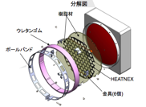
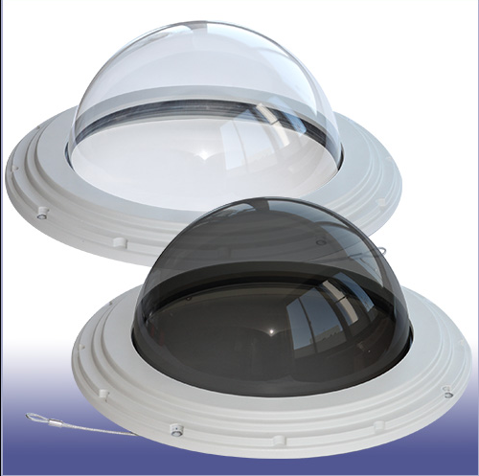

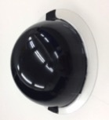
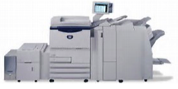
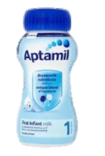




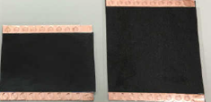
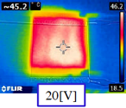
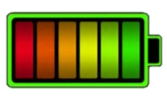
CNT Paint Heater (HeatNexⓇ)
Correspond to Japan Police Dept. Spec. for traffic signal cover
(Ver. 3)
Light Transmittance (minimum) : Pass
Green: 360 cd, Yellow: 720 cd, Red: 360 cd
Phantom Ratio (reflection ratio) : Pass
Energy supply: DC 24 ~ 100V
Freeze-thaw performance is tested in field
Transparent Heating Sheet
for traffic signal
Security Camera Cover
With Heater
Applications in Market Places
Luke warm robot hand & fingers
Laminate thin flat heaters
3D Heater
Milk heater
HeatNexⓇ Paper type
Paper Types
Paint Heater
3D Heater
Further applications
Progress

Slide 20
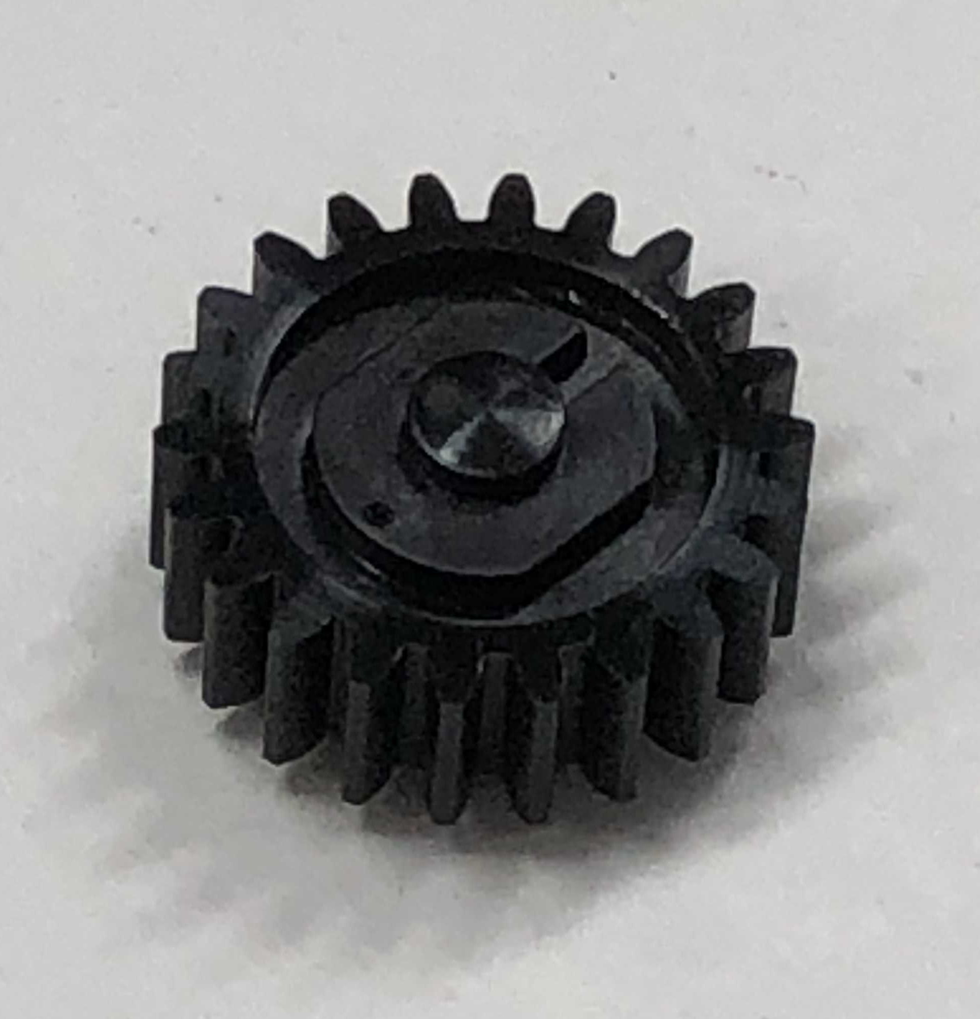
CNT Resin Composite
BEFORE
Siddarmark Introduces…
Resin composite is the first CNT application.
Facing the difficulty of non-uniform CNT distribution in resin.
Causing unexpected crack and mechanical failure.
Only conductive carry-tray for electronics parts
Homogeneous CNT distribution in resin.
CNT-Nylon 66 composite, and others (PE, PP).
No dust generated during processing or in-use; can be replaced from glass-fiber Nylon 66 composite.
Anti-static
Tougher & Durable
CNT Nylon composite
Nylon 66
Siddarmark’s low cost CNT Nylon composite
No dust like Glass fiber reinforced Nylon either molding nor using
Good to combine with CFGP to remove metal
Fig. 1 About 10 mm diameter gear for precision instrument (production trial) .

Slide 21
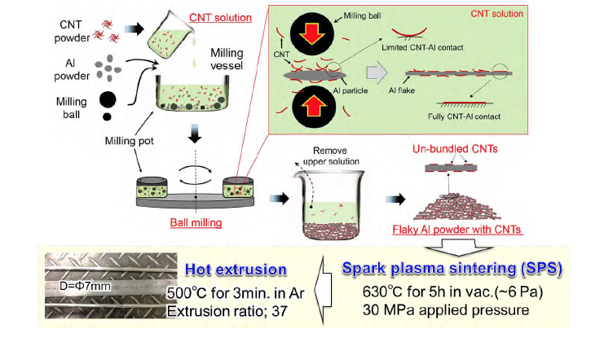
CNT Metal Composite
From Web by Prof. Kondo at Osaka Univ.

Slide 22
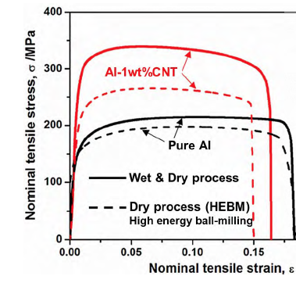
Al-CNT Mechanical Strength Change
From Web by Prof. Kondo at Osaka Univ.

Slide 23
CNT Yarn, Ribbon Sensors, Artificial Muscle
Objectives | Technology | Present Positions
Pure & Long Yarn Sensors Artificial Muscle | Dry Vertically-aligned DWCNTs Homogeneous size distribution Direct spinning (Primary Yarn) Secondary spinning from plural primary yarns Weaving into polymer yarns to make sensor tapes | Ribbon tape sensor (Movie) Gage Factor > 20 (The best in the world) Motion & Touch sensor available Tactile sensor (Need AI) Exhibited at Wearable Expo & Nano Expo Submitted the patent Preparing the sensor patent
Ultra light weight wire High mechanical strength | Homogeneous long yarn Metal-plated over the yarn Ultra highly pure Low cost manufacturing Higher specific strength | Manufacturing trial of metal-plated yarn (Successfully done) Preparation of large scale production Mesh-shield wire with the plated yarn

Slide 24
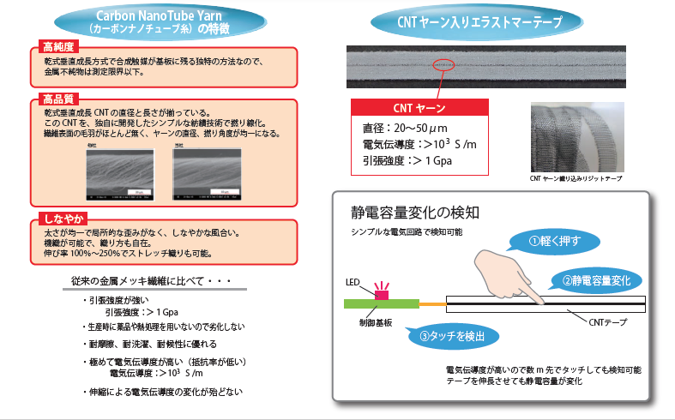
CNT Sensor Tape with CNT Yarn
Characteristics of CNT Yarn
Elastic Tape with CNT Yarn
High Purity
Unique Vertically-aligned growth brings no metal inclusion in CNTs
High Quality
CNT Yarn
Vertically-aligned array gives homogeneous length and diameter of CNTs.
Yarn is homogeneously spun from the array without pilling
Diameter: 20-50 µm
Conductivity: > 10³ S/m
Tensile strength: > 1 GPa
Gage Factor > 20
Photo: Rigid CNT yarn tape
Flexibility
Detection of capacitance change
Flexible and homogeneous yarn
Various weaving patterns
Stretchable up to 250%
A simple circuit works to pick it up
1. Tap the tape
In comparison with conventional metal coated yarns;
Higher Tensile strength
Durable because of no chemical treatment
Durable & Washable
Higher conductivity
No change of conductivity with stretch
2. Capacitance
Change
Control
Board
3. Detection
CNT tape

Slide 25
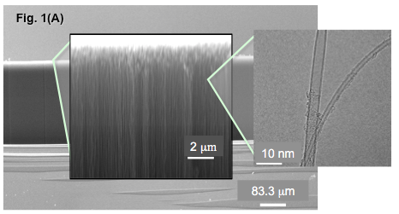
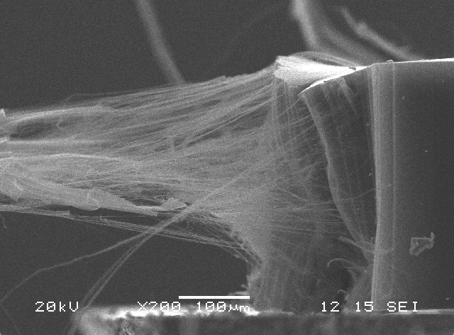
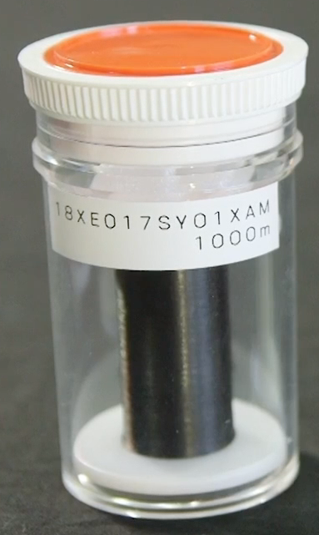
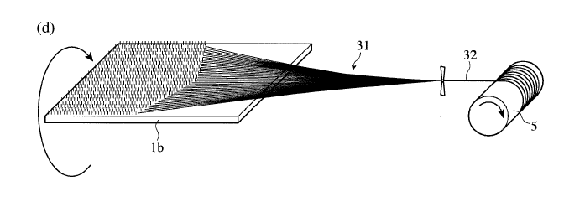
Technical Description
Double-Walled Carbon Nanotube (DWCNTs)
DWCNTs drawn & twisted to yarn
Sugikuro® Yarn
Vertically Aligned
Technology
Sugikuro® Yarn 1. Dry Vertically-aligned DWCNTs from Okayama Univ. Homogeneous, No metal residue, no distribution of length or diameter. 2. Synthesis tech., Direct spinning (Primary Yarn) & Secondary spinning from plural primary yarns (Patent filed JP2017-185701). 3. Weaving into polymer yarns to make sensor tapes (Pat. filed).
Sugikuro® CNT Ribbon Tape Woven cloth: Like fabric cloth, flexible, no metal, easy to use. Weaving pattern & tape width can be determined by request Durable & washable as like fabric products
Comparison
 | Sugikuro® | Univ of TX | Taiyo-Nissan , Murata, Yamaha, Hitach Eng. , etc | China (Tsinghau Univ, etc)
Homogeneity | > 99% | Large MWCNT size distribution
Resistivity [S/m] | > 10⁵ | < 10 | < 10⁰ | <10
Sensing | Touch, motion, tactile | ? | Motion | Touch, motion
Industrialized | Yes | No | Yes but not homogeneous | No (Lab sample)
Woven to cloth | Yes | Impossible Sheet only | No | Yes but Lab sample
Gage Factor | > 20 | ~ 2 | 2 to 10 | ~ 2

Slide 26
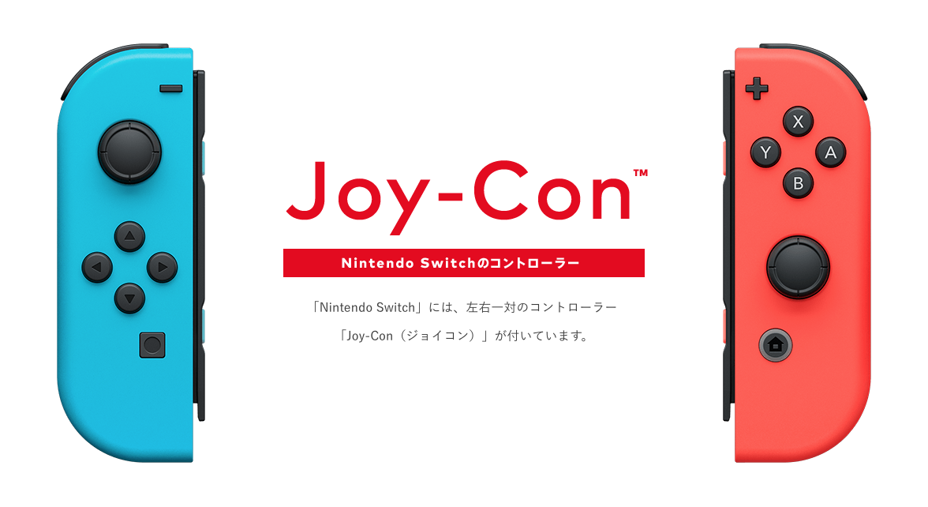

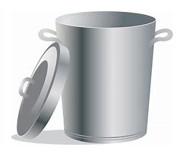
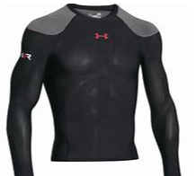
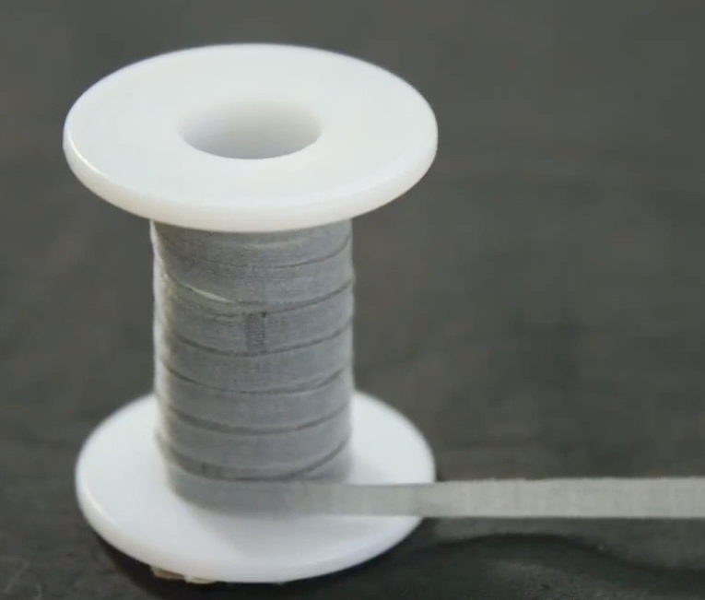
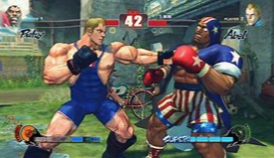
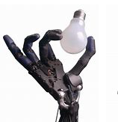
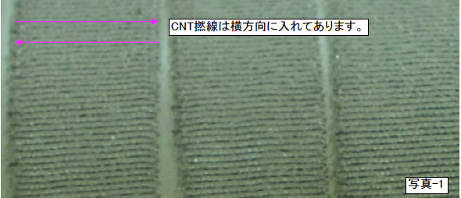
Electrical Characteristics
Impedance & Inductance are linear & proportional
Impedance
Inductance
Current
CNT yarns are woven horizontally
CNT yarns pitch
Sugikuro® CNT Tape sensor directly coverts muscle motion to digital signal, which gives realistic action in VR. And eliminate conventional controllers.
With Sugikuro® pulse sensor, nerve /myoelectric signal enhances VR performance excitingly.
The tape sensor feeds back motion to AI, which allows fine motions of robot
As tactile sensor, robot hands, etc can “feel” touch (tactile sensing).
The sensor tape width
Motion can be converted to electrical signal proportionally.
The curve shapes are carefully considered when use the full bound of pitch scale.

Slide 27

Blood Pressure & Pulse Monitor
Objectives | Technology | Present Position
Simple and easy to use with the conventional monitor | Homogeneous CNT sheet & yarn | Band-Aid type sample
2. Performance | Watch our YouTube motion picture

Slide 28
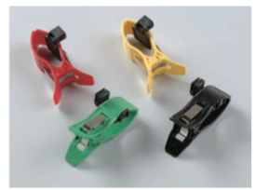
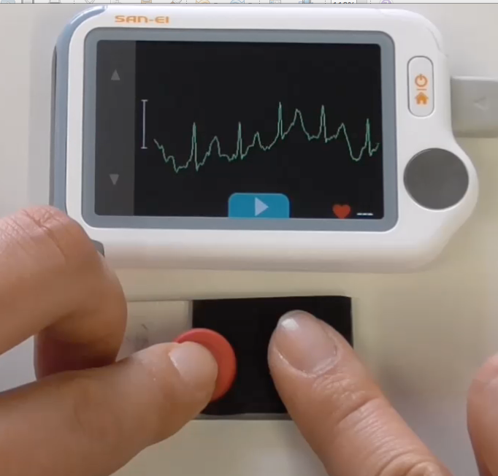
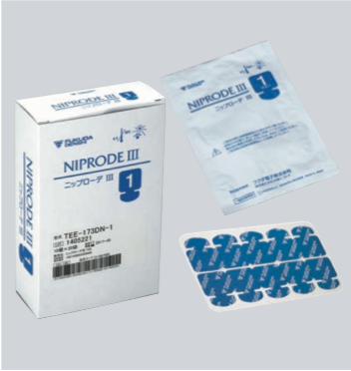
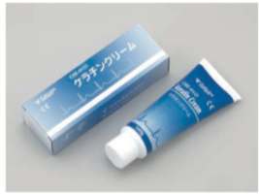
Blood Pressure & Pulse Sensor
Conventional sensors
for cardiograph
Siddarmark sensors
for cardiograph
What is New
Thin, flexible, & No-Metal
(Metal button is used as a connector in the photo)
Easy to use without conductive cream on skin
Utilize existing monitors
Plugs
Only one “Band Aid” tape
Need to replace to
a smart terminal
Disposable metal sensors
The above is our hand-made using Band Aid tape, which is not sophisticated but works well, though. We need a partner to brush it up!
Electrical-enhance cream

Slide 29


ARTIFICIAL MUSCLE with CNT YARN
We supply the CNT yarn
Nylon-CNT yarn combination
Relationship between current & load
Response: 1mN/sec

Slide 30

Carbon Fiber Glued Press ( CFGP®)
Objectives | Technology | Present Position
Glued press of CF cloth Thermoplastics only Within 5 min press operation | Ordinary temp operation Glued by thermoplastic resin Two kinds resins（~60 deg C、200 deg C） Press operation within 5 minutes, reducing operational cost | Go to mass manufacturing Complete 3D shaping with edges Bounce-Back resiliency No separation of sheet by physical shock Engine oil durability
No sheet separation No brittle fracture | Sheet separation test was conducted Resin penetration into mono filament level (Pictures below) Bullet test by Malaysia Police Academy | Metal cap 0.375 Magnum: No fracture by the bullet Bullet stop Engine oil soaking test conducted: No damage
SEM pictures of the glued conditions
Secondary electron
microscopy
Secondary electron microscopy
with carbon mapping
Secondary electron microscopy
with titanium mapping

Slide 31









CFGPⓇ (Carbon Fiber Glued Press)
Strength
CFGP Target
FMC 9 mm
Glock 17
Flexible Robot Body
Expected Auto Parts
Shooting instructor
Shooting results（Primary test）：
2 of 5 pierced
Possible to stop 0.375 Magnum
Resiliency
Peeling test by Univ.：
CF cloth tears off before the peeling
Peel-off test
No Brittleness
Progress

Slide 32
CFRP & CFGP: Comparison of Work-Hour
CFRP/CFRTP
CFGP
Conventional Press machines

Slide 33




CFGP: Comparison with CFRP
 | CFGP | Prepreg | CFRP
Cost | Much lower | High | High
CF loss | Minimal | Significant | Much
Flexibility | > 180 deg. bending 100% reversible | Rigid | Rigid
Characteristics | No tear-off No strip | Brittle Rupture | Brittle Rupture
Electrical conductivity | Conditional | No | No
Fig.1 A sample of CFGP. Double layers of CF clothes were pressed to be form (Manufactured by Wing Co. Ltd., Saitama, Japan). A) A upholstery part, B) Behind of A; It is evident that the press work simply forms the shape from the mold. C) An enlarged picture of the 3D sharp edge. D) Another 3D sharp edge.
A
B
C
D

Slide 34


Copper Electric-Plated CNT Yarn
Objectives | Technology | Present Positions
The world first electric cable with CNT yarn Electric-plated Industrial | Dry Vertically-aligned DWCNTs Homogeneous size distribution Direct spinning (Primary Yarn) Standard electric-plated processing | Copper plated yarn Physical property is similar to the metal wire Preparing shield mesh from the copper plated CNT yarn
8 µm thick Plated copper
35 µmΦ CNT yarn
46 µmΦ
Figure 1. The cross section of Cu plated CNT yarn. The original shape of cross section is complete round but it is collapsed slightly due to the cutting. No exfoliation is observed.
Figure 2. The copper electroplated CNT yarn without the normal surface treatment of the metal plated process.
Copper thickness : 6 ~ 8 µm
Conductivity: 24.4 Ω/m (cf. Annealed Cu 50µmΦ = 8.96 Ω/m ,Al composite ~ 15 Ω/m)
Density ratio (Cu plated CNT yarn/ Cu wire) = 0.55
45% weight reduction.

Slide 35



CNT Membrane
Imitate bio-aquaporin
Utilize the hollow tubes of CNTs
Predicted high flux like aquaporin
High Proton transfer; predicting high flux separators for battery
No macro scale result had not been reported
Holt, et al., Science 312 (2006)
Tunuguntla, et al., Nat Nano 2016.43 (2016)

Slide 36



Macro Size CNT Membrane
Matsumoto, Tsuruoka, et al., Carbon 120 (2017)

Slide 37










Nano Carbons make it possible: Humanoid
CNT composite Joint
CNT Muscle
CNT Muscle
CNT sensor
(Tactile)
CF composite skeleton
CNT heater
warm skin
CNT EMS
CFGP armor
CNT sensor
to balance
CFGP Shell

Slide 38


Nano Carbon Materials: Ultimate Goal
Sensing + Flat heater + CFGP + CNT composite
-> Revolution of robot technology
Natural smile
Multiple-spindle
Robot goes to Humanoid by rid of motors and gear boxes
Stretch the spine by attitude control of foot with touch sensors

Slide 39
Summary
Watch Myth, Fake, and Real.
It is important to understand characteristics of nano carbons.
Two step industrialization: Disperse or Assemble nano carbons, then Mix or Post treatment.
An ultimate goal is to make humanoid.

